Slide 1

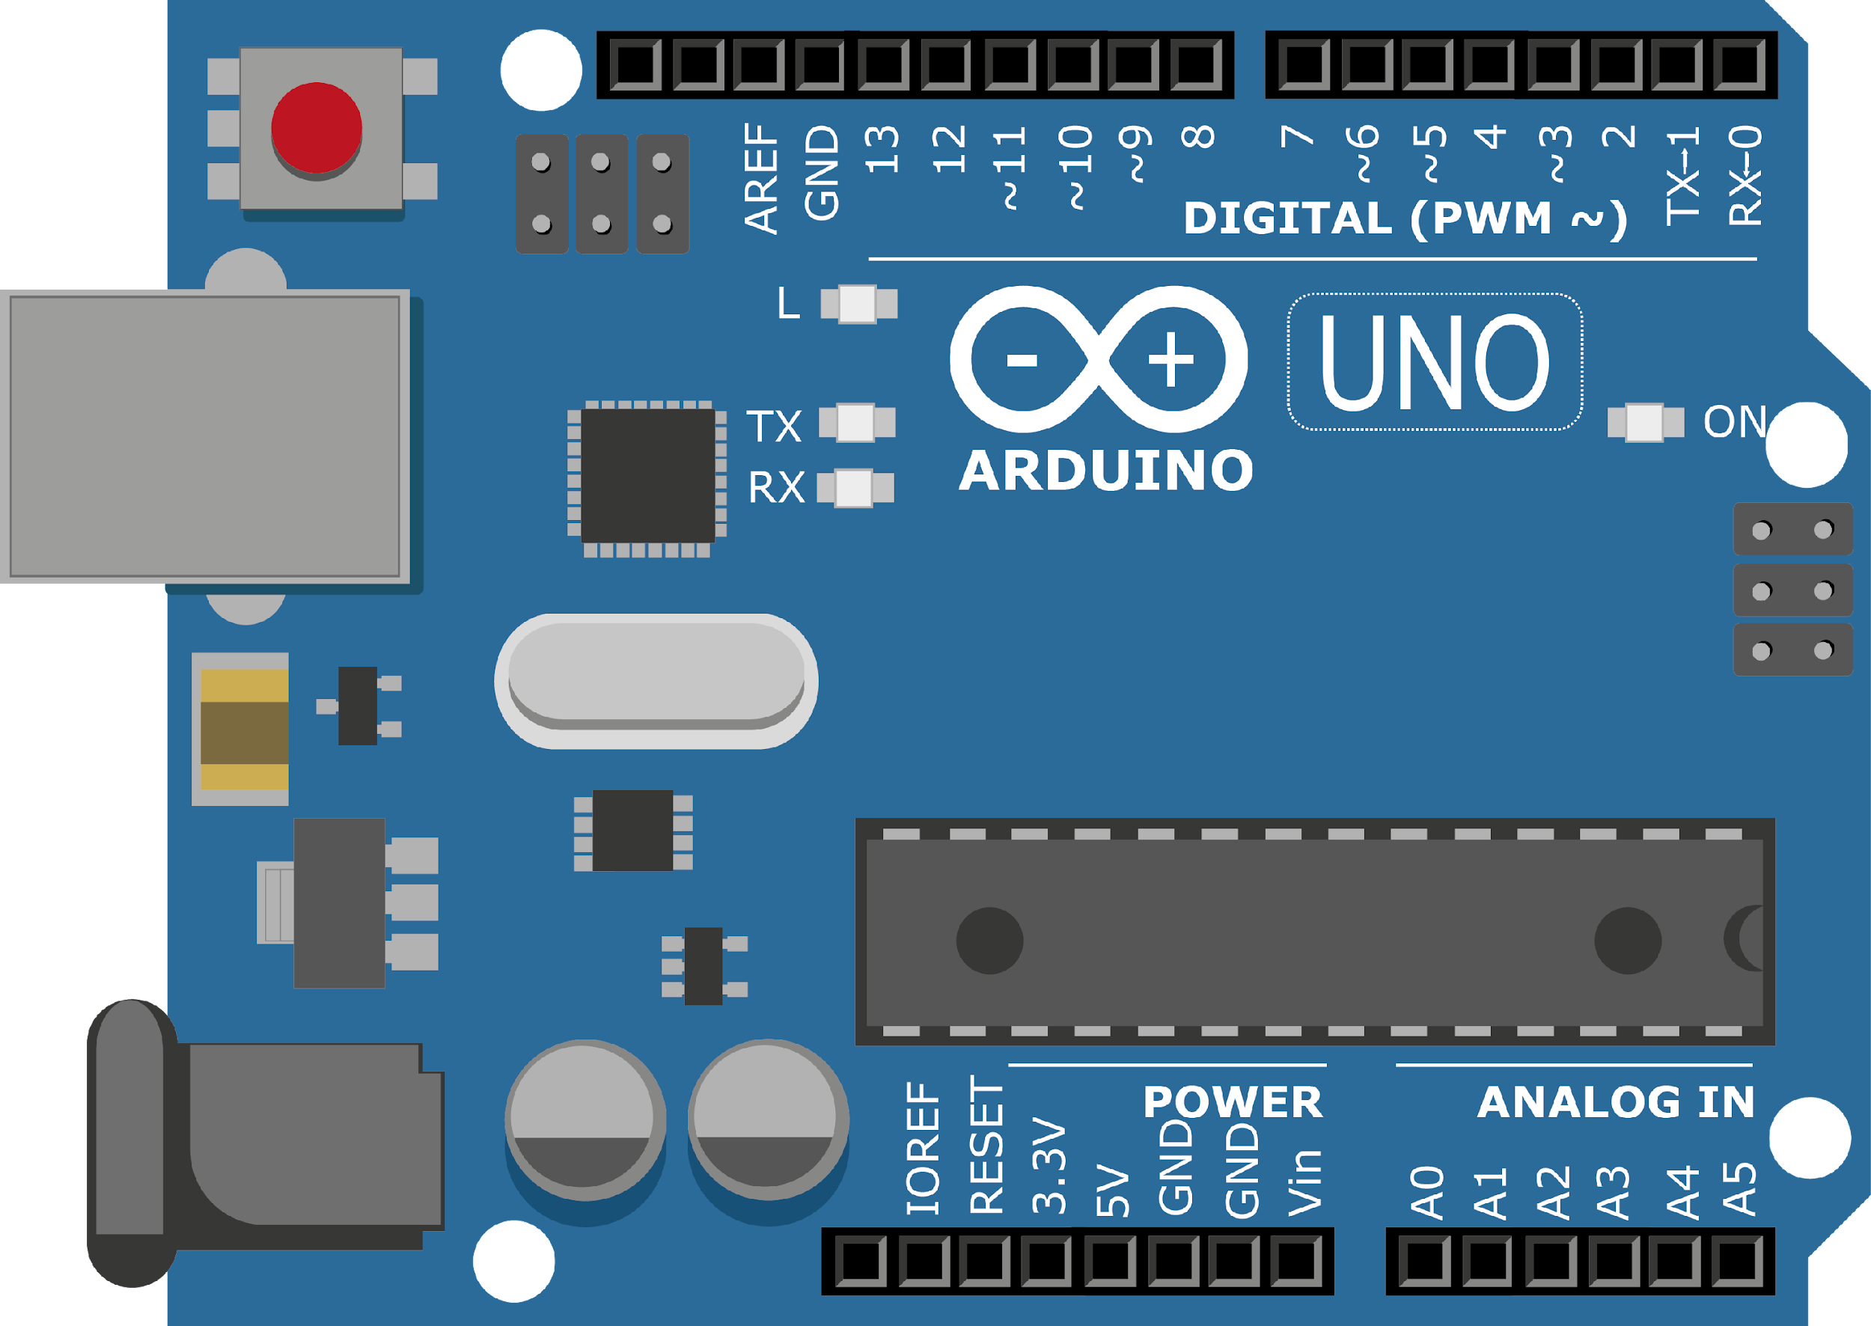
ARDUINO MASTER CLASS
14
RADAR using Ultrasonic & Matlab

Slide 2
14 AGENDA
02
03
01
RADAR using Ultrasonic
RADAR
Q & A

Slide 3
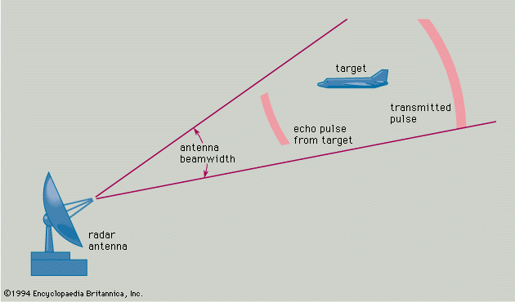
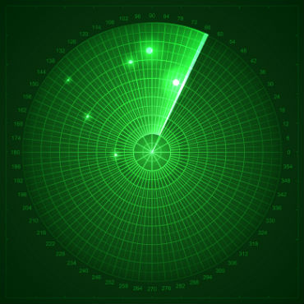
RADAR-RAdio Detection And Ranging
Radar, electromagnetic sensor used for detecting, locating, tracking, and recognizing objects of various kinds at considerable distances.
It operates by transmitting electromagnetic energy toward objects, commonly referred to as targets, and observing the echoes returned from them.

Slide 4
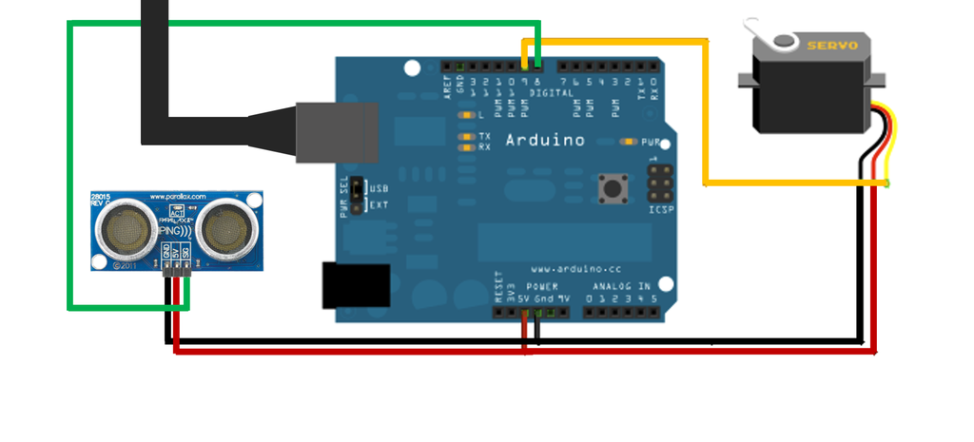
Circuit diagram

Slide 5
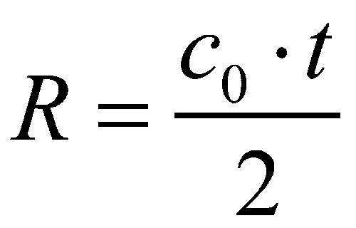

INTERVIEW QUESTIONS
Types of Radar
RADAR
Range or distance measurement of RADAR
Radar, electromagnetic sensor used for detecting, locating, tracking, and recognizing objects of various kinds at considerable distances. It operates by transmitting electromagnetic energy toward objects, commonly referred to as targets, and observing the echoes returned from them.
Bistatic radar | Continuous-wave radar | Doppler radar | Fm-cw radar | Monopulse radar | Passive radar | Planar array radar | Pulse-doppler.
c0 = speed of light = 3·108 m/s
t = measured runtime [s]
R = slant range antenna - aim [m]

Slide 6

THANKS!

